Slide 1
Introduction to Macro Economics
Principles of Macro Economics 1
ECONA 201

Slide 2
Introduction to Macroeconomics
Macroeconomics deals with the economy as a whole; it examines the behavior of economic aggregates such as aggregate income, consumption, investment, and the overall level of prices.
  Aggregate behavior refers to the behavior of all households and firms together.

Slide 3
Macroeconomic Concerns
Three of the major concerns of macroeconomics are:
  Inflation
  Output growth
  Unemployment

Slide 4
Inflation and Deflation
Inflation is an increase in the overall price level.
Hyperinflation is a period of very rapid increases in the overall price level. Hyperinflations are rare, but have been used to study the costs and consequences of even moderate inflation.
Deflation is a decrease in the overall price level. Prolonged periods of deflation can be just as damaging for the economy as sustained inflation.

Slide 5
Output Growth:
Short Run and Long Run
The business cycle is the cycle of short-term ups and downs in the economy.
The main measure of how an economy is doing is aggregate output:
  Aggregate output is the total quantity of goods and services produced in an economy in a given period.

Slide 6
Output Growth:
Short Run and Long Run
A recession is a period during which aggregate output declines. Two consecutive quarters of decrease in output signal a recession.
A prolonged and deep recession becomes a depression.
Policy makers attempt not only to smooth fluctuations in output during a business cycle but also to increase the growth rate of output in the long-run.

Slide 7
Unemployment
The unemployment rate is the percentage of the labor force that is unemployed.
The unemployment rate is a key indicator of the economy’s health.
The existence of unemployment seems to imply that the aggregate labor market is not in equilibrium. Why do labor markets not clear when other markets do?

Slide 8
Government in the Macroeconomy
There are three kinds of policy that the government has used to influence the macroeconomy:
  Fiscal policy
  Monetary policy
  Growth or supply-side policies

Slide 9
Government in the Macroeconomy
Fiscal policy refers to government policies concerning taxes and spending.
Monetary policy consists of tools used by the Federal Reserve to control the quantity of money in the economy.
Growth policies are government policies that focus on stimulating aggregate supply instead of aggregate demand.

Slide 10
The Components of the Macroeconomy
The circular flow diagram shows the income received and payments made by each sector of the economy.

Slide 11

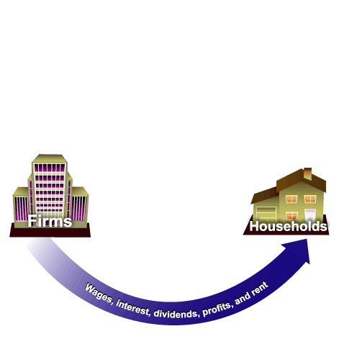
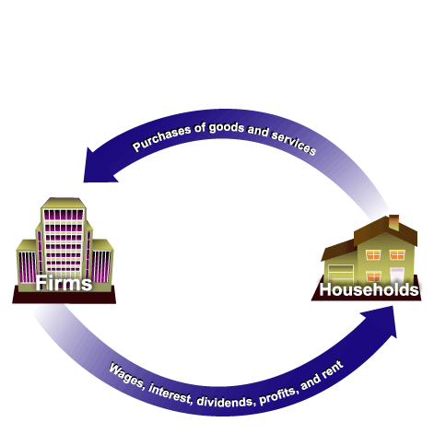
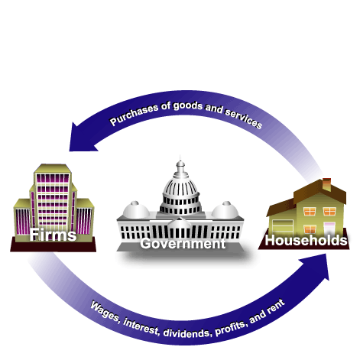
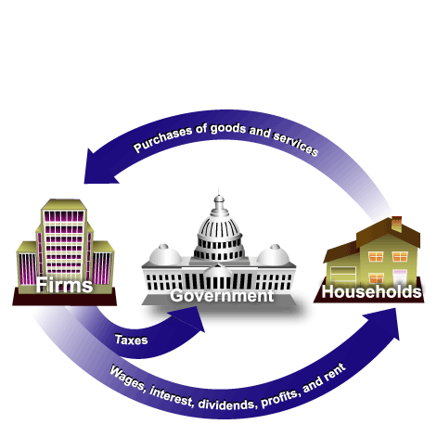
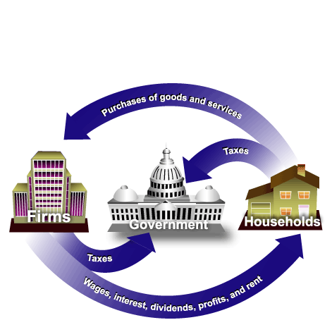
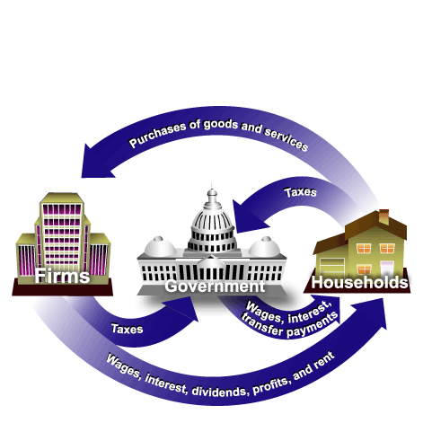
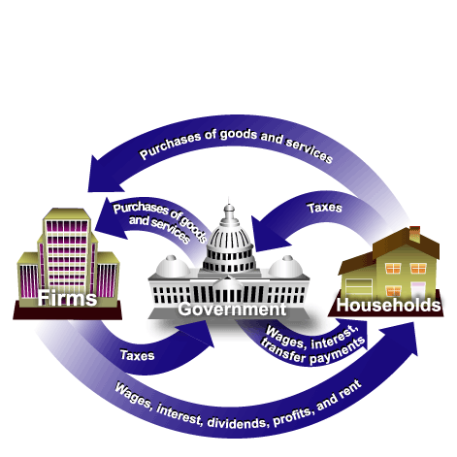
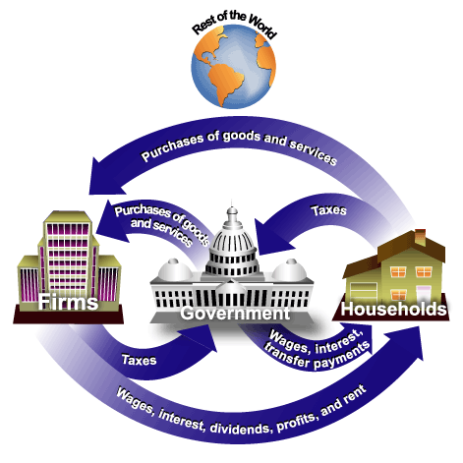
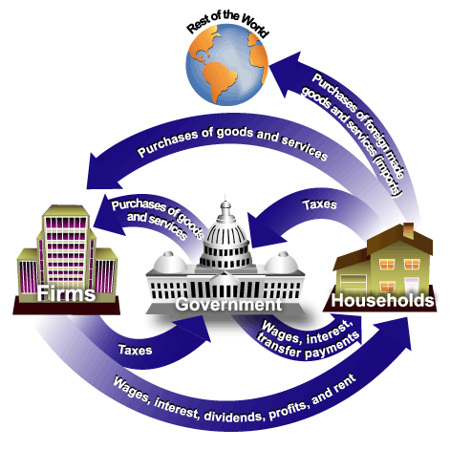
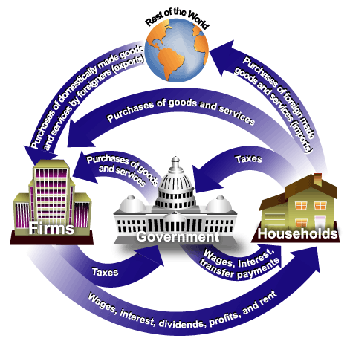
The Components of the Macroeconomy
Everyone’s expenditure is someone else’s receipt. Every transaction must have two sides.

Slide 12
The Components of the Macroeconomy
Transfer payments are payments made by the government to people who do not supply goods, services, or labor in exchange for these payments.

Slide 13
The Methodology of Macroeconomics
Connections to microeconomics:
  Macroeconomic behavior is the sum of all the microeconomic decisions made by individual households and firms. We cannot understand the former without some knowledge of the factors that influence the latter.

Slide 14
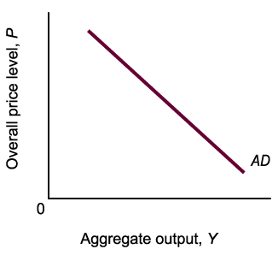
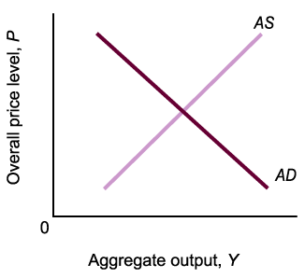
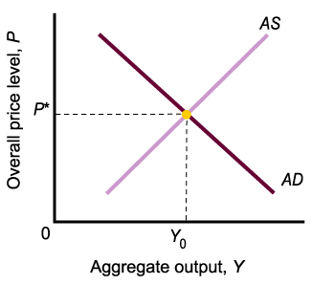
Aggregate Supply and
Aggregate Demand
Aggregate demand is the total demand for goods and services in an economy.
Aggregate supply is the total supply of goods and services in an economy.
Aggregate supply and demand curves are more complex than simple market supply and demand curves.

Slide 15
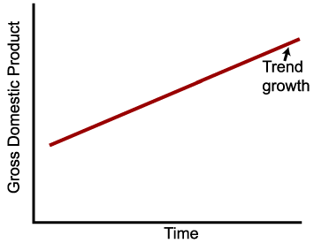
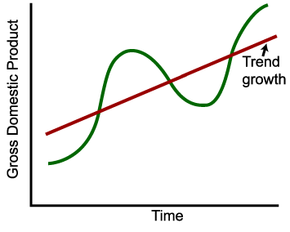
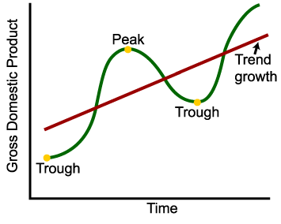
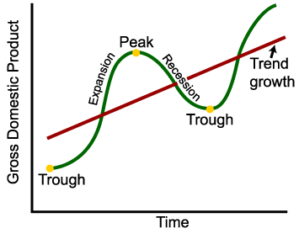
Expansion and Contraction:
The Business Cycle
An expansion, or boom, is the period in the business cycle from a trough up to a peak, during which output and employment rise.
A contraction, recession, or slump is the period in the business cycle from a peak down to a trough, during which output and employment fall.

